Slide 1
AI Study Group
Hands-on Machine Learning with Scikit-Learn, Keras & Tensorflow, Géron, 3rd Edition, Chapter 19 Discussion
May 29, 2024

Slide 2
Chapter 19: Training and Deploying Tensorflow Models
Tensorflow Serving
Vertex AI
GPU Considerations
Other Vertex AI Considerations
Final Thoughts on the Book

Slide 3
A. Tensorflow Serving
A serving system is a software infrastructure designed to deploy, manage, and serve machine learning models in production environments. The primary purpose of a serving system is to make trained models available for use by applications and end-users, allowing them to generate predictions or inferences in real-time or batch model.
TensorFlow Serving (TS) is a serving system written in C++ and designed for machine learning models. Developed by Google, it also supports serving models trained with other machine learning frameworks. It is a “wrapper” for models ready to be deployed.

Slide 4
A. Tensorflow Serving
TS supports versioned models, allowing updates and rollbacks. It can deploy new versions of models without downtime.
TS provides both REST API and gRPC interfaces, making it easy to integrate with different client applications. A REST API is an API that uses standard HTTP verbs such as GET, POST, PUT and DELETE, and uses JSON as inputs and outputs. The gRPC protocol is more complex but more efficient – data is exchanged using protocol buffers.
TS is widely used for deploying machine learning models in production due to its robustness and ease of integration with the TensorFlow ecosystem.

Slide 5
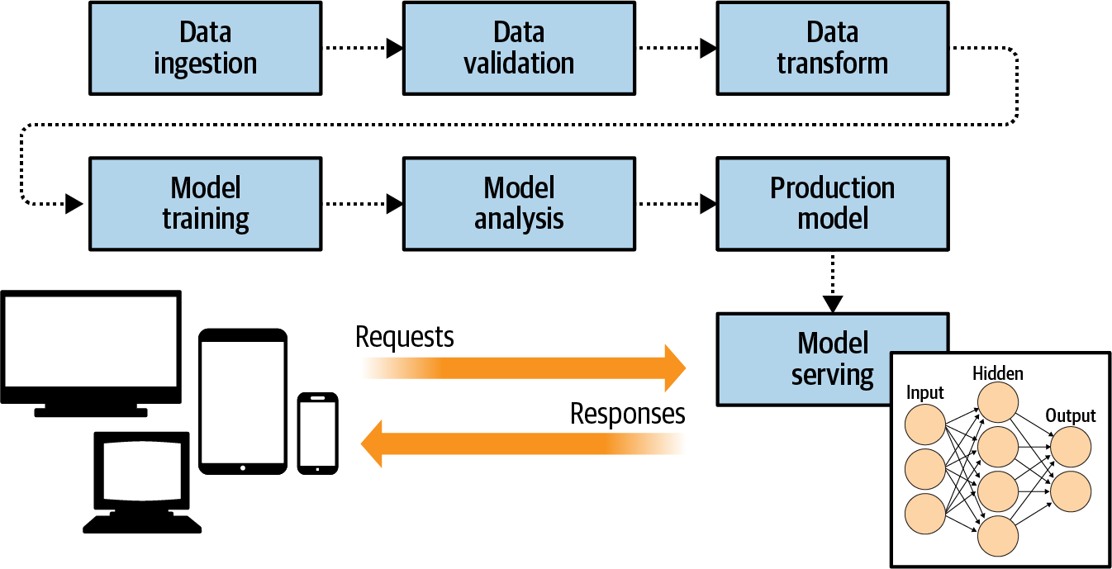
Tensorflow Serving (Moroney, AI and Machine Learning for Coders)
Notes:
Model serving is useful in deploying a model when it has gone though the model development process.

Slide 6
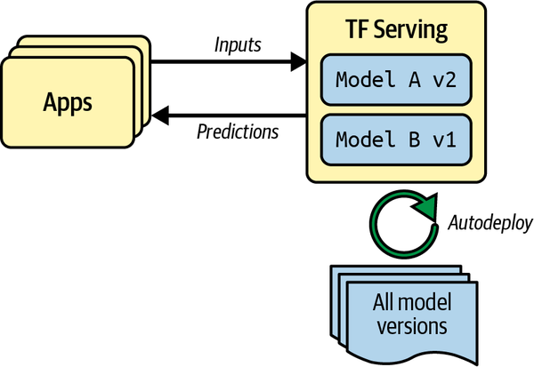
Tensorflow Serving (Géron, Figure 19-1)
Notes:
TF Serving is very flexible – it can serve multiple versions of your models and deploy the latest versions.

Slide 7
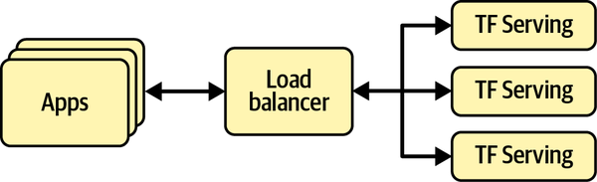
Scaling up TF Serving with Load Balancing (Géron, Figure 19-2)
Notes:
If there are too many queries in a short period of time, a solution is to employ multiple servers. The illustration is an example of TF Serving on multiple servers and load balancing queries.

Slide 8
A. Tensorflow Serving - Implementation
TS can be implemented in a variety of ways:
System’s package manager
Docker image/container
Installing from the source
TS can be implemented in Ubuntu with the following steps:
Install the tensorflow-model-server package.
Save the absolute path of the base model directory.
Start the server.

Slide 9
A. Tensorflow Serving - Code
Install the tensorflow-model-server package (running on Colab):
if "google.colab" in sys.modules or "kaggle_secrets" in sys.modules:
url = "https://storage.googleapis.com/tensorflow-serving-apt"
src = "stable tensorflow-model-server tensorflow-model-server-universal"
!echo 'deb {url} {src}' > /etc/apt/sources.list.d/tensorflow-serving.list
!curl '{url}/tensorflow-serving.release.pub.gpg' | apt-key add -
!apt update -q && apt-get install -y tensorflow-model-server
%pip install -q -U tensorflow-serving-api
2. Save the absolute path of the base model directory:
import os
os.environ["MODEL_DIR"] = str(model_path.parent.absolute())
Notes:
Checks if the code is running in Google Colab or Kaggle. Defines the TensorFlow Serving APT repository URL and package names. Adds the TensorFlow Serving APT repository to the list of sources. Adds the GPG key for the repository to the list of trusted keys. Updates the package list and installs TensorFlow Serving using APT. Installs the TensorFlow Serving API Python package. This setup ensures that TensorFlow Serving and its API are installed on the machine, allowing you to serve machine learning models and interact with them via the API.
Imports the os module: to interact with the operating system's environment variables. Sets the MODEL_DIR environment variable: to the absolute path of the parent directory of the model_path. This is typically used to set up environment variables that can be accessed by other parts of the application or by subprocesses spawned by the application, ensuring that the path to the model directory is consistently available.

Slide 10
A. Tensorflow Serving - Code
3. Start the server.
%%bash --bg
tensorflow_model_server \
--port=8500 \
--rest_api_port=8501 \
--model_name=my_mnist_model \
--model_base_path="${MODEL_DIR}" >my_server.log 2>&1
Notes:
This script runs the TensorFlow model server in the background, serving the "my_mnist_model" model on port 8500 for gRPC and port 8501 for REST API, and logs all outputs and errors to my_server.log.

Slide 11
B. Google Vertex AI
Google's Vertex AI is a managed machine learning platform designed to build, deploy, and scale machine learning models. It provides a unified environment that integrates Google's machine learning tools and services, simplifying the end-to-end process of developing and managing machine learning workflows.
Vertex AI simplifies the deployment and management of models, supporting versioning, monitoring, and scaling to ensure reliable and efficient operation in production environments.
By providing these comprehensive features, Vertex AI helps organizations streamline their machine learning workflows, from data preparation and model training to deployment and monitoring, enhancing productivity and accelerating time to value.

Slide 12
B. Vertex AI - Implementation
Vertex AI can be implemented as follows:
Login to Google Cloud Services, create a project ID, and enable Vertex AI and Cloud Storage API.
Authenticate to use Google Cloud Service (Vertex AI).
Create a Google Cloud Storage bucket to store the SavedModel.
Upload the model directory to the bucket.
Tell Vertex AI about the model.
Create an endpoint and deploy the model in Vertex AI.

Slide 13
B. Vertex AI - Implementation
Vertex AI can be implemented as follows:
Login to Google Cloud Services, create a project ID, and enable Vertex AI and Cloud Storage API.
Create a Google Cloud Services account (if necessary).
Google Cloud Services will automatically create a project ID (use this in code).
Enable Vertex AI and Cloud Storage API within Google Cloud Services.
Change the name of bucket ID in the code (slide 15).

Slide 14
B. Vertex AI - Code
Authenticate to use Google Cloud Service (Vertex AI).
project_id = "my_project" ##### CHANGE THIS TO YOUR PROJECT ID #####
if "google.colab" in sys.modules:
from google.colab import auth
auth.authenticate_user()
elif "kaggle_secrets" in sys.modules:
from kaggle_secrets import UserSecretsClient
UserSecretsClient().set_gcloud_credentials(project=project_id)
else:
os.environ["GOOGLE_APPLICATION_CREDENTIALS"] = "my_service_account_key.json"
Notes:
Sets the Google Cloud project ID: to be used in subsequent operations. Checks the execution environment: (1) Google Colab: Uses Colab's authentication method to authenticate the user. (2) Kaggle: Uses Kaggle's secret management to set Google Cloud credentials. (3) Local Machine: Sets the environment variable for Google Cloud credentials using a service account key file. This setup ensures that the code can authenticate and access Google Cloud services regardless of whether it is running in Google Colab, Kaggle, or a local environment.

Slide 15
B. Vertex AI - Code
Create a Google Cloud Storage bucket to store the SavedModel.
from google.cloud import storage
bucket_name = "my_bucket" ##### CHANGE THIS TO A UNIQUE BUCKET NAME #####
location = "us-central1"
storage_client = storage.Client(project=project_id)
bucket = storage_client.create_bucket(bucket_name, location=location)
#bucket = storage_client.bucket(bucket_name) # to reuse a bucket instead
Notes:
Imports the necessary storage library: for interacting with Google Cloud Storage. Defines the bucket name and location: where the bucket will be created. Creates a storage client: to interact with Google Cloud Storage. Creates a new bucket: with the specified name and location or references an existing bucket if that line is uncommented. By the end of this process, you will have a new bucket created in Google Cloud Storage, or you will have a reference to an existing bucket, which you can then use for various storage operations, such as uploading or downloading files.

Slide 16
B. Vertex AI - Code
Upload the model directory to the bucket.
def upload_directory(bucket, dirpath):
dirpath = Path(dirpath)
for filepath in dirpath.glob("**/*"):
if filepath.is_file():
blob = bucket.blob(filepath.relative_to(dirpath.parent).as_posix())
blob.upload_from_filename(filepath)
upload_directory(bucket, "my_mnist_model")
Notes:
Imports the necessary Path class: for handling filesystem paths. Defines a function: that uploads all files in a given directory to a Google Cloud Storage bucket. Converts the directory path to a Path object: for easier manipulation. Iterates over all files and directories: in the specified directory recursively. Checks if each path is a file: and uploads it to the Google Cloud Storage bucket. Uploads files using relative paths: to maintain the directory structure in the bucket. By the end of this process, all files in the my_mnist_model directory are uploaded to the Google Cloud Storage bucket, preserving their relative paths within the directory structure.

Slide 17
B. Vertex AI - Code
Tell Vertex AI about the model.
from google.cloud import aiplatform
server_image = "gcr.io/cloud-aiplatform/prediction/tf2-gpu.2-8:latest"
aiplatform.init(project=project_id, location=location)
mnist_model = aiplatform.Model.upload(
display_name="mnist",
artifact_uri=f"gs://{bucket_name}/my_mnist_model/0001",
serving_container_image_uri=server_image,
)
Notes:
Imports the necessary AI Platform library: to interact with Google Cloud AI Platform. Defines the server image: that will be used to serve the model. Initializes the AI Platform client: with the appropriate project and location. Uploads the model: to the specified project and location, using the specified Docker image for serving. By the end of this process, the model is uploaded to Google Cloud AI Platform and is ready to be deployed to an endpoint for serving predictions.

Slide 18
B. Vertex AI - Code
Create an endpoint and deploy the model in Vertex AI.
endpoint = aiplatform.Endpoint.create(display_name="mnist-endpoint")
endpoint.deploy(
mnist_model,
min_replica_count=1,
max_replica_count=5,
machine_type="n1-standard-4",
accelerator_type="NVIDIA_TESLA_K80",
accelerator_count=1
)
Notes:
This code creates an endpoint named "mnist-endpoint" in Google Cloud's AI Platform and deploys a machine learning model (mnist_model) to it. The deployment is configured to use between 1 and 5 instances of the "n1-standard-4" machine type, each with one NVIDIA Tesla K80 GPU. This setup ensures that the model can handle varying levels of traffic efficiently.
However, this is where the model stopped executing due to a resource limit (GPU) reached. I recommend changing the code to from 5 to 1 and 4 to 2 (see code in red). Note: an endpoint is a network-accessible address where a deployed machine learning model can be accessed to perform predictions or other tasks.

Slide 19
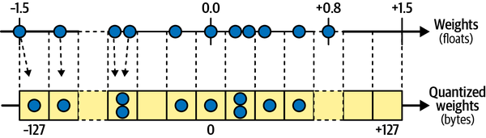
Quantization (Géron, Figure 19-5). Useful when deploying a model to an embedded or mobile device (TFLite).
Notes:
To reduce model size, TFLite can quantize model weights to fixed-point, 8-bit integers. This leads to a fourfold size reduction (compared to 32-bit floats). A simple approach (illustrated above) is post-training quantization: it finds the maximum absolute weight value, m, then maps the floating-point range, -m to +m (e.g., -1.5 to +1.5), to fa fixed-point range -127 to +127.

Slide 20
C. GPU Considerations
Generally, one should place data processing operations on the CPU, and place neural network operations on the GPU.
GPU have relatively narrow communication bandwidth and so it is better to avoid unnecessary data transfers to and from the GPU.
Adding CPU RAM is simple and relatively inexpensive, whereas adding GPU RAM is expensive because it is embedded in the GPU.

Slide 21
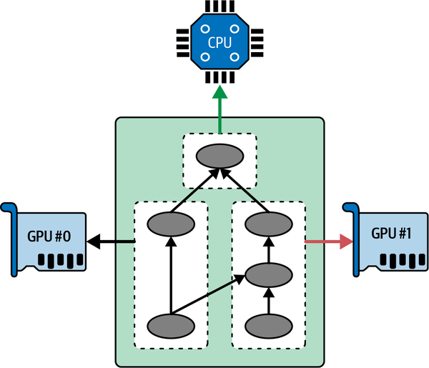
Executing a Tensorflow graph across multiple devices in parallel (Géron, Figure 19-6)
Notes:
Here is an illustration of distributing computations across the CPU and multiple GPU devices on a single machine.

Slide 22
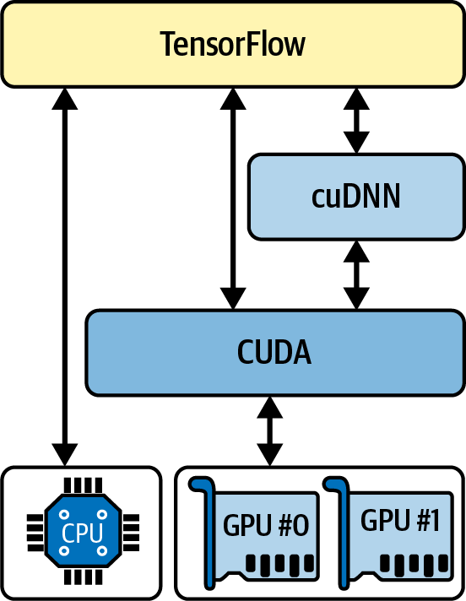
Tensorflow using CUDA and cuDNN to control GPUs. (Géron, Figure 19-7)
Notes:
With a NVIDIA GPU cared, one needs to install the Nvidia drivers and libraries: Compute Unified Device Architecture Library (CUDA) toolkit and the CUDA Deep Neural Network library (cuDNN). CUDA allows developers to use CUDA-enabled GPUs for various computations (including graphics acceleration). The cuDNN is a GPU-accelerated library of common DNN computations such as activation layers, normalization, forward and backward convolutions, and pooling.

Slide 23
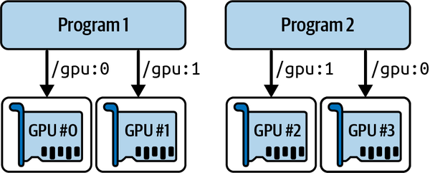
Each program gets two GPUs. (Géron, Figure 19-8)
Notes:
If one needs to run multiple programs (or models) on the same machine and allocate GPU, one can split the GPU RAM between programs or models. Above, Program 1 is assigned GPU 0 and GPU 1, and Program 2 is assigned GPU 2 and GPU 3.

Slide 24
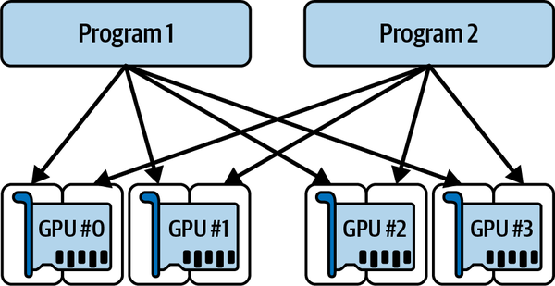
Each program gets all four GPUs, but only 2 GB of RAM on each GPU. (Géron, Figure 19-9)
Notes:
Another option in allocating GPU is to allow each program a specific amount of GPU RAM. If each GPU above has 4 GB of RAM and each program is constrained to 2 GB for each GPU, then the Tensorflow can allocate GPU resources as shown above.

Slide 25
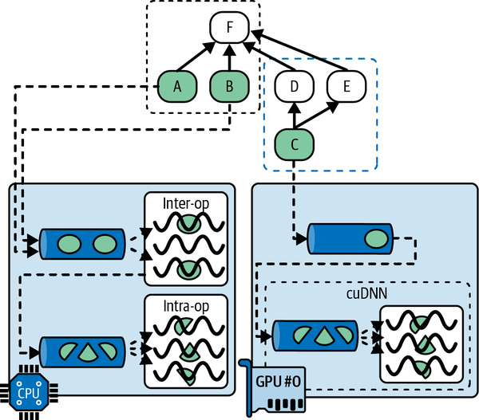
Order of execution. (Géron, Figure 19-10)
Notes:
The book provides an example of the order of execution for CPU and GPU. In this example, the execution of operations A, B, C, D, E, and F are evaluated. Operations A and B are evaluated using the CPU. The CPU has the inter-op and intra-op thread pools, and if the CPU has multiple cores, then the operations will be evaluated in parallel. If some operations have multithreaded CPU kernels, then the kernels are split into suboperations and dispatched to the intra-op thread pool. Operation C is evaluated by the GPU, which evaluates the operations sequentially. Most operations in the GPU have multithreaded kernels and implemented by CUDA and cuDNN and have their own thread pool (which uses parallel processing). Once the dependency counter for a program reaches 0, then it executed by Tensorflow. Suppose C reaches 0 first, then B (then F would have a dependency count of 3 from 4). Then A, D, E finish, then F can finish because it now has a 0 dependency count.

Slide 26
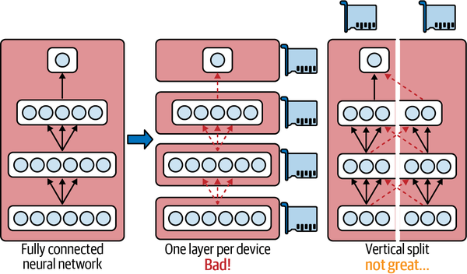
Splitting a fully connected neural network. (Géron, Figure 19-11)
Notes:
The book discusses model parallelism and data parallelism. As an example of model parallelism, suppose we wanted to train a single neural network across multiple devices. The illustration above shows the difficulty in splitting a fully connect neural network. Splitting a model horizontally with one layer per device can be problematic because each subsequent device would have to wait for the previous device to complete its operations (per the previous slide) to start its computations. Splitting the model vertically can be challenging even though the work is done in parallel, the next half layer would have to wait on the completion of the both halves of the previous layer.

Slide 27
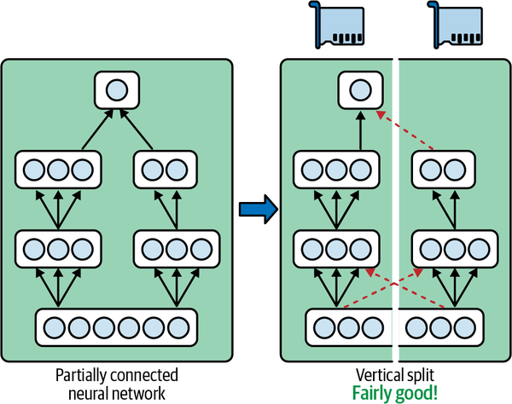
Splitting a partially connected neural network. (Géron, Figure 19-12)
Notes:
However, when a neural network is partially connected (as shown above), splitting the model into two devices can be more successfully achieved. For example, some convolutional neural networks are constructed as partially connected network.

Slide 28
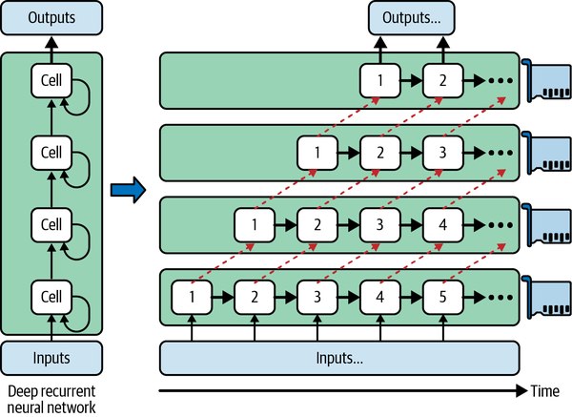
Splitting a deep recurrent neural network. (Géron, Figure 19-13)
Notes:
In addition, deep recurrent neural network can be split more efficiently across multiple GPUs. For example, one could split the network horizontally by placing each layer on a different device and feed the network with an input sequence to process.

Slide 29
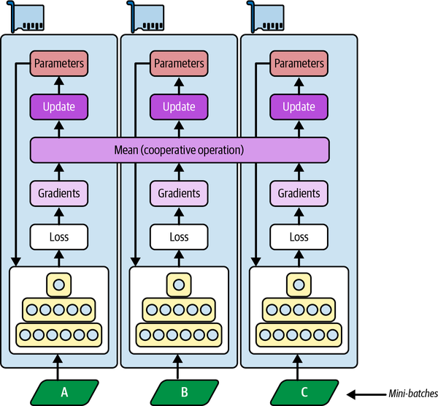
Data parallelism using a mirrored strategy. (Figure 19-14)
Notes:
One way to implement data parallelism is to use a mirrored strategy. With a mirrored strategy, all the model parameters across all GPUs are completely mirrored and the exact same parameter updates are applied. All replicas always remain perfectly identical, and it is efficient especially when using a single machine. The difficulty comes from efficiently computing the mean of all gradients from all of the GPUs and then distribute the results across all the GPUs.

Slide 30
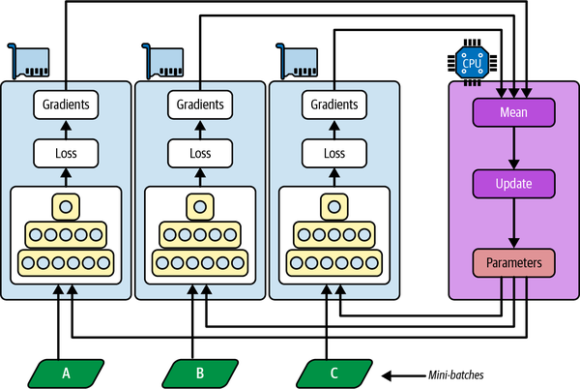
Data parallelism using centralized parameters. (Géron, Figure 19-15)
Notes:
Another approach for data parallelism stores the model parameters outside of the GPU devices performing the computations. With this approach, one can place the parameters on one or more CPU-only servers called parameter servers, which only update parameters. A difference between the mirrored approach and the centralized approach is that the former imposes synchronous weight updates, and the centralized approach allows either synchronous or asynchronous updates. With synchronous updates, the aggregator waits until all gradients are available before it compute the average gradients and passes them to the optimizer, which will update the model parameter. With asynchronous updates, whenever a replica has finished computing the gradients, the gradients are immediately used to update the model parameters. Asynchronous updating may seem advantageous due to its simplicity and absence of synchronization delay, but it may result in stale gradients.

Slide 31

PipeDream’s pipeline parallelism. (Géron, Figure 19-17)
Notes:
Another potential problem with data parallelism is bandwidth saturation. The centralized approach requires the communication of model parameters from parameter servers to every replica at the beginning of each training step, and the gradients in the other direction at the end of each training step. The mirrored strategy produces gradients from GPU that need to be shared with other GPU. A 2018 proposed a solution: a system called PipeDream, using a technique called pipeline parallelism – a combination of model and data parallelism. The model is chopped into consecutive parts (stages), each of which is trained a different machine. This would result in an asynchronous pipeline in which all machines work in parallel with very little idle time. But this approach may suffer from stale gradients.

Slide 32
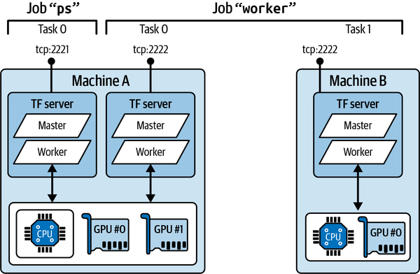
An example Tensorflow cluster. (Géron, Figure 19-18)
Notes:
A Tensorflow cluster is a group of Tensorflow processes running in parallel, usually on different machines, and talking to each other to complete some work (e.g., training or executing a neural network). In the illustration, the cluster specification definesa cluster with three tasks – two workers and one parameter server.

Slide 33
D. Other Vertex AI Considerations
Running Large Training Jobs on Vertex AI – using many GPUs and servers to train a very large model may be more efficiently conducted on the Google Cloud Service (Vertex AI).
Hyperparameter Tuning on Vertex AI – based on a Bayesian optimization algorithm, it can find the optimal combination of hyperparameters quickly.

Slide 34
D. Final Thoughts on the Book
The book covered many topics well, but sometimes the details in the book did not seem necessary to explain the concepts or principles.
The book focuses on the Tensorflow/Keras/Scikit Learn libraries.
Certain sections of the book are quickly becoming dated.
The book did not cover cost considerations in developing machine learning models well.
Overall, a very good introductory text on machine learning.

